Slide 2
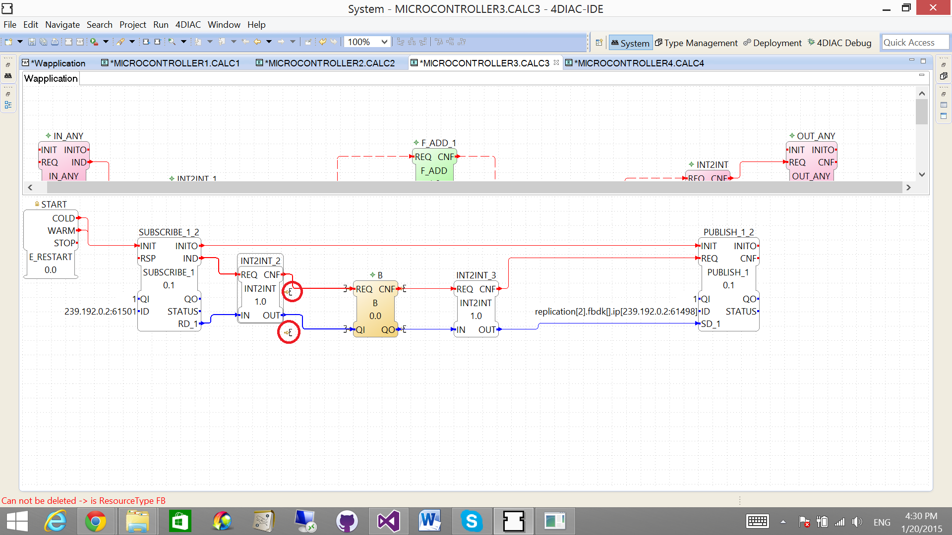
4DIAC-IDE-LOGIC-EDITOR_E001A

Slide 3
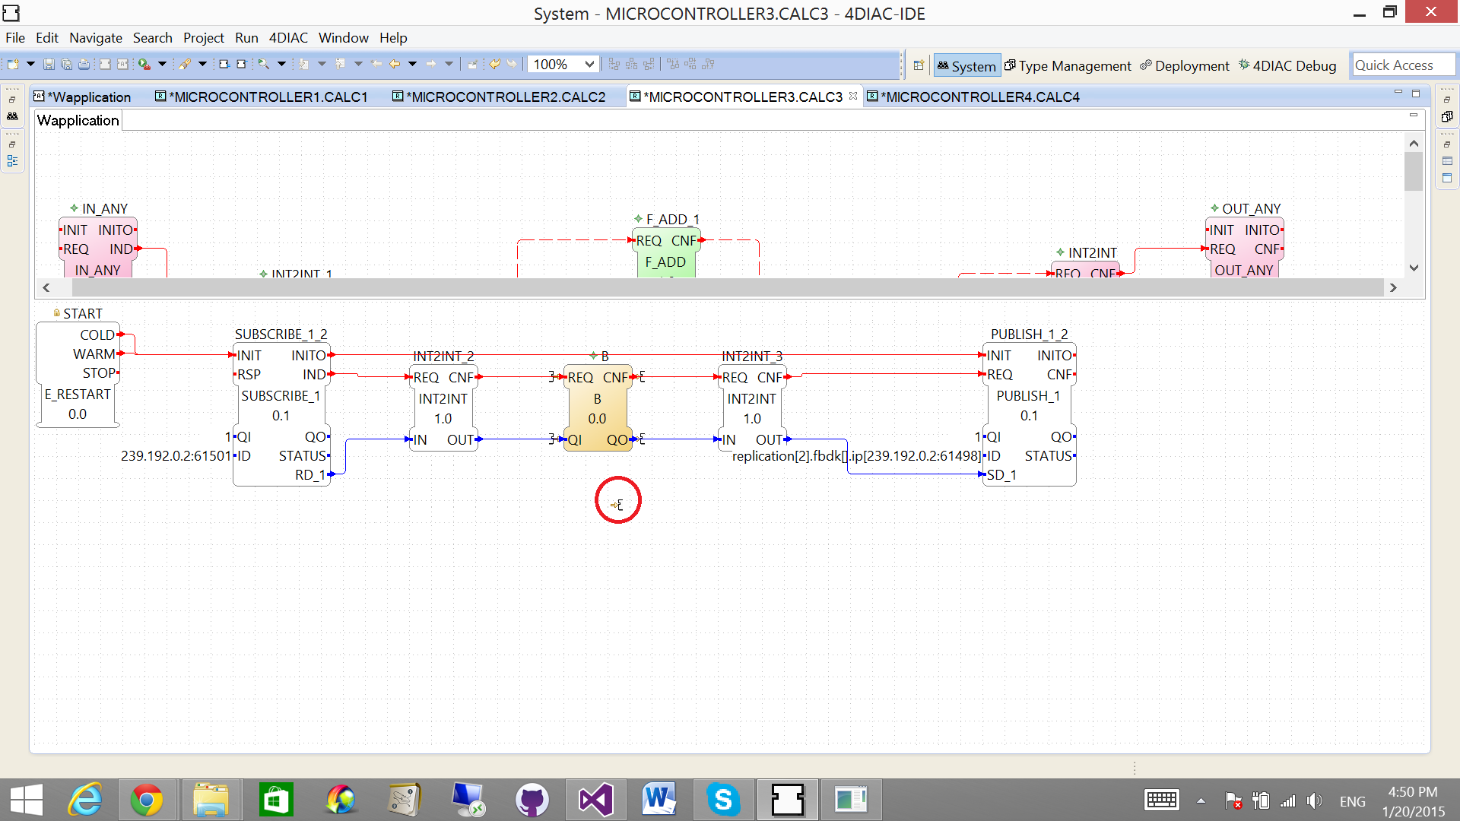
4DIAC-IDE-LOGIC-EDITOR_E002A

Slide 4
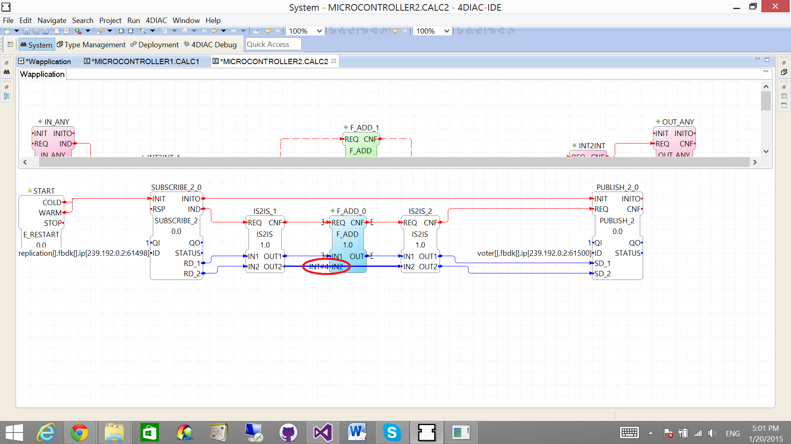
4DIAC-IDE-LOGIC-EDITOR_E001B

Slide 5
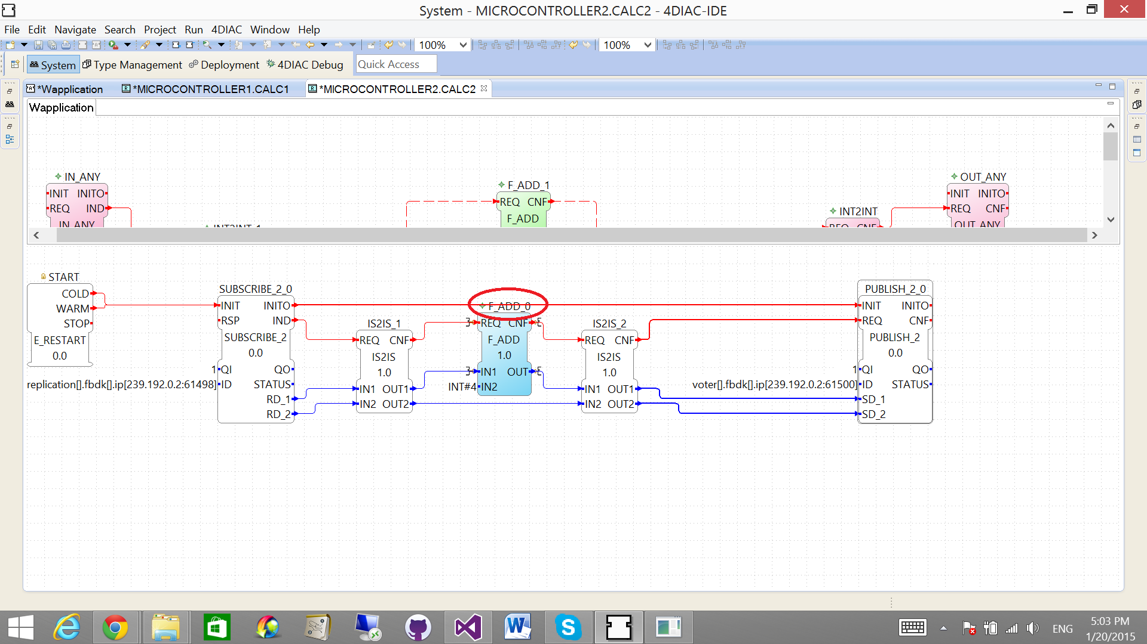
4DIAC-IDE-LOGIC-EDITOR_E002B

Slide 6
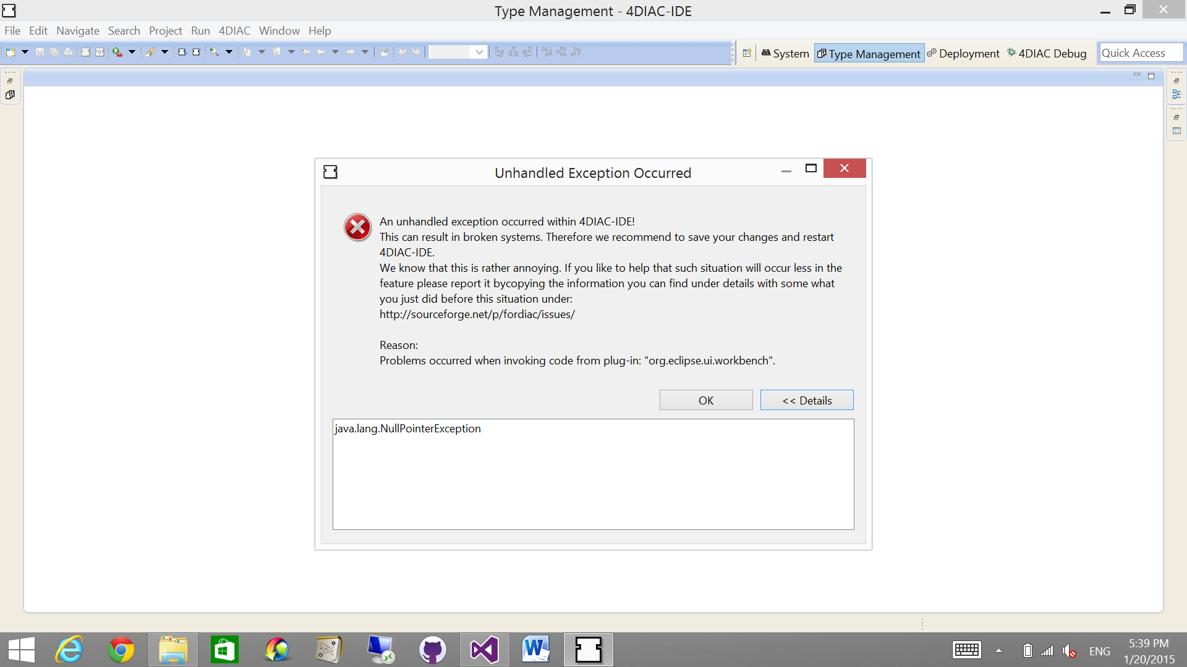
4DIAC-IDE-LOGIC-EDITOR_E001C

Slide 7
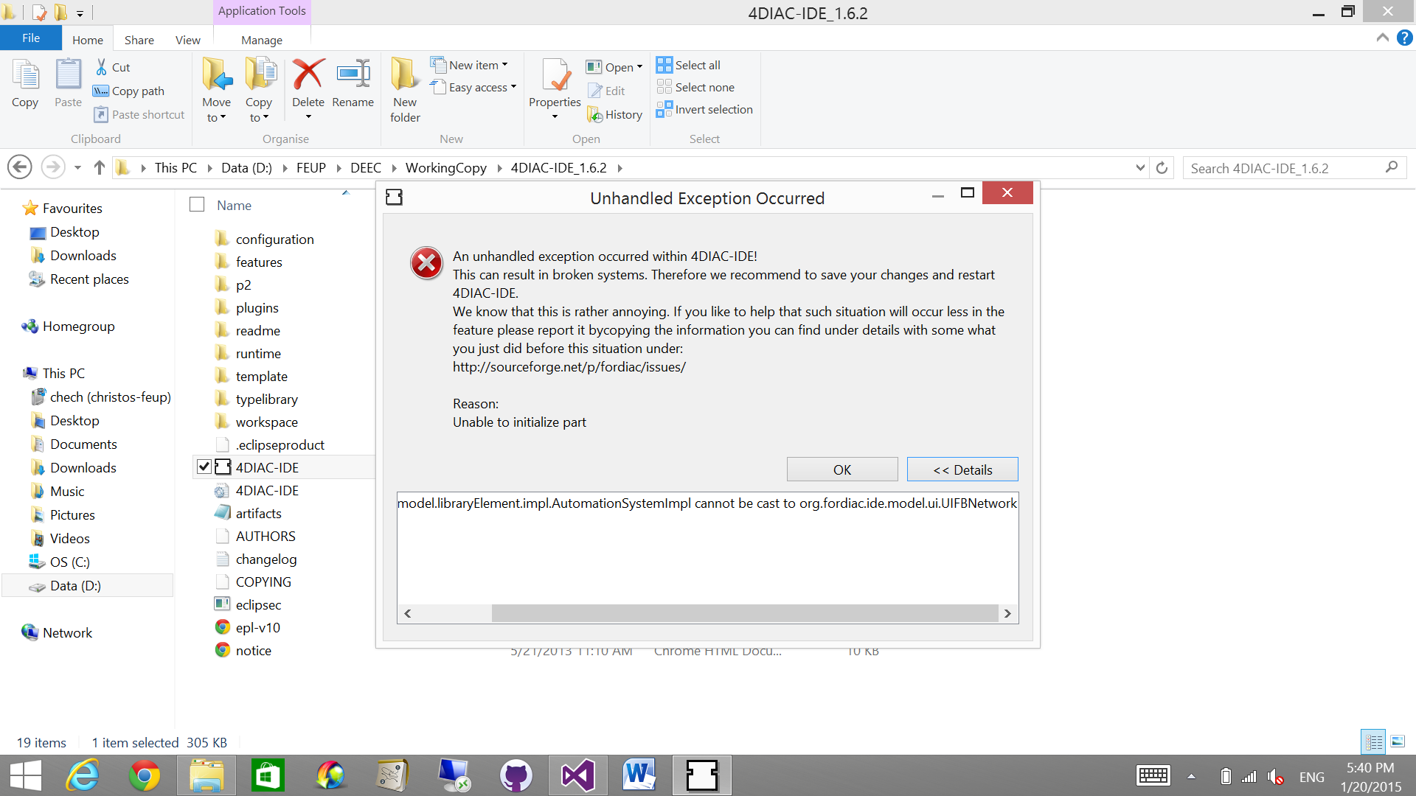
4DIAC-IDE-LOGIC-EDITOR_E002C

Slide 8
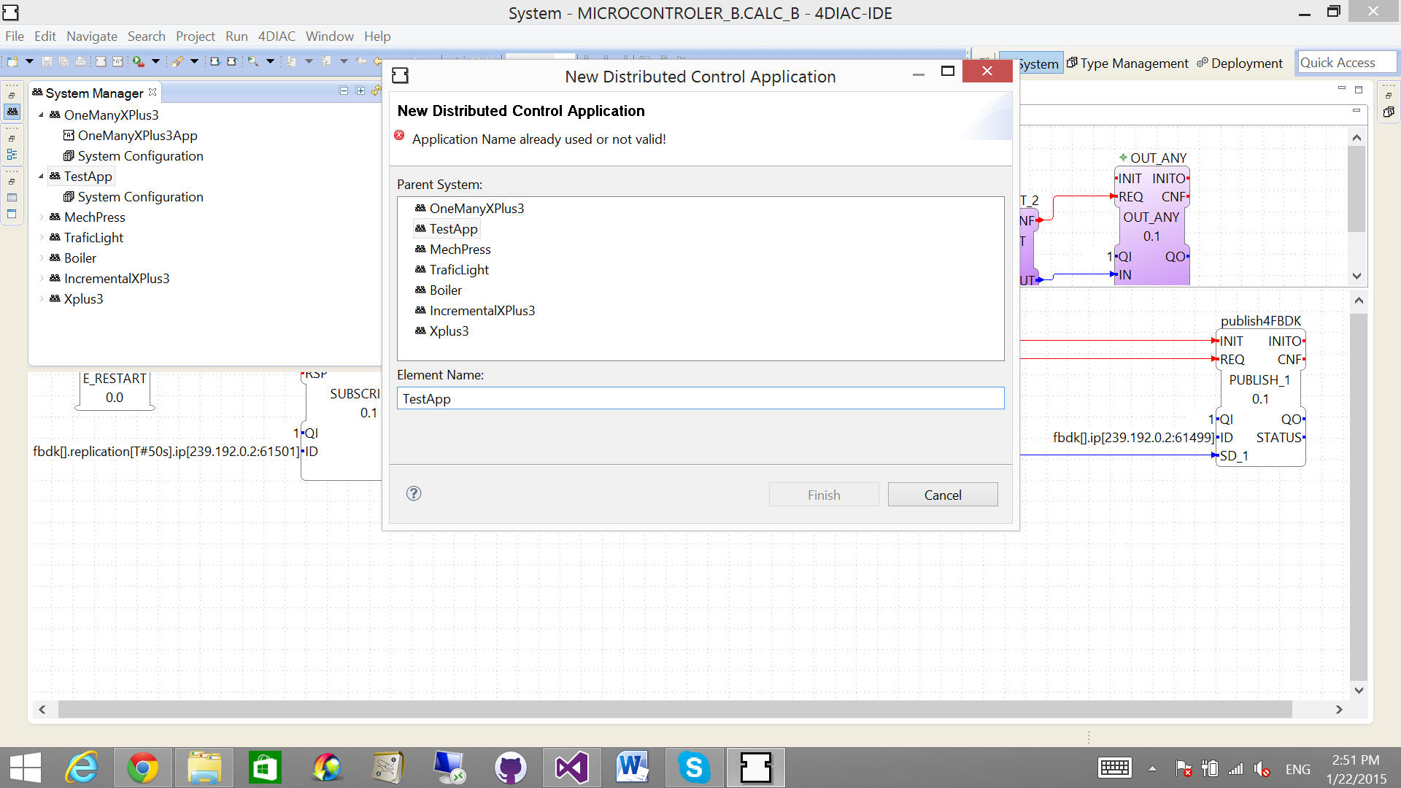
4DIAC-IDE-LOGIC-EDITOR_E003C

Slide 9
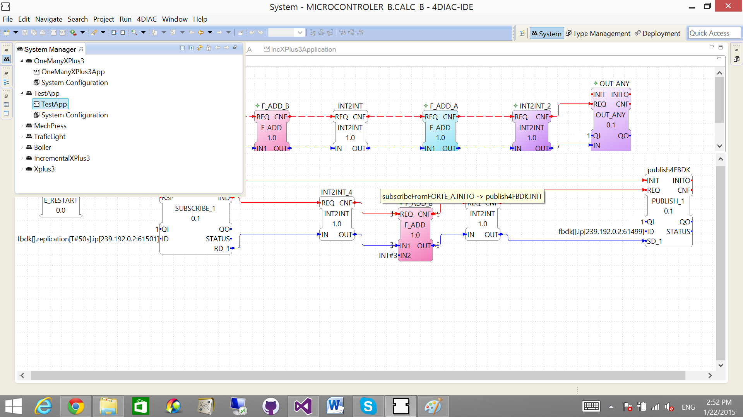
4DIAC-IDE-LOGIC-EDITOR_E004C

